Slide 1
Time Tracker App
Made by: Spencer Yates
1

Slide 2
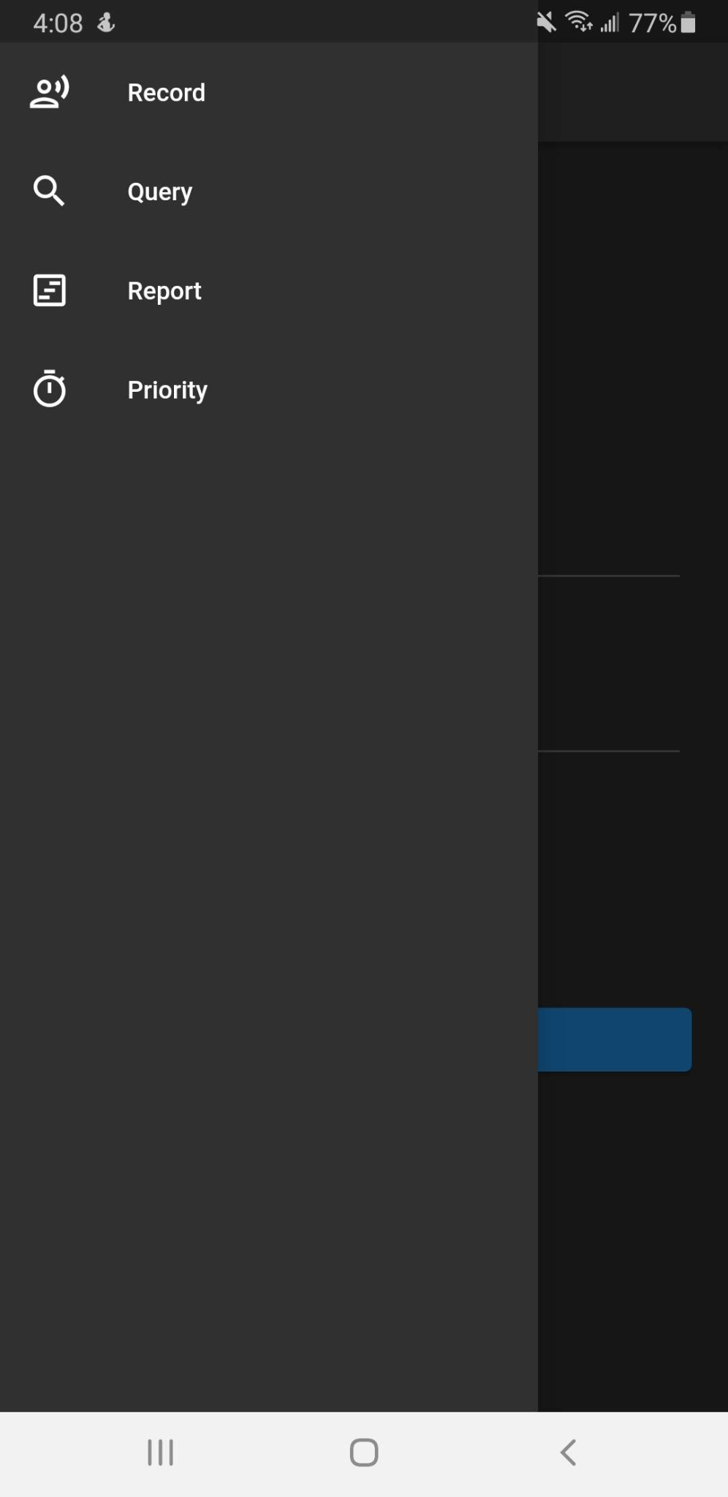
What is it?
A program made to track time and find how time is spent
2

Slide 3
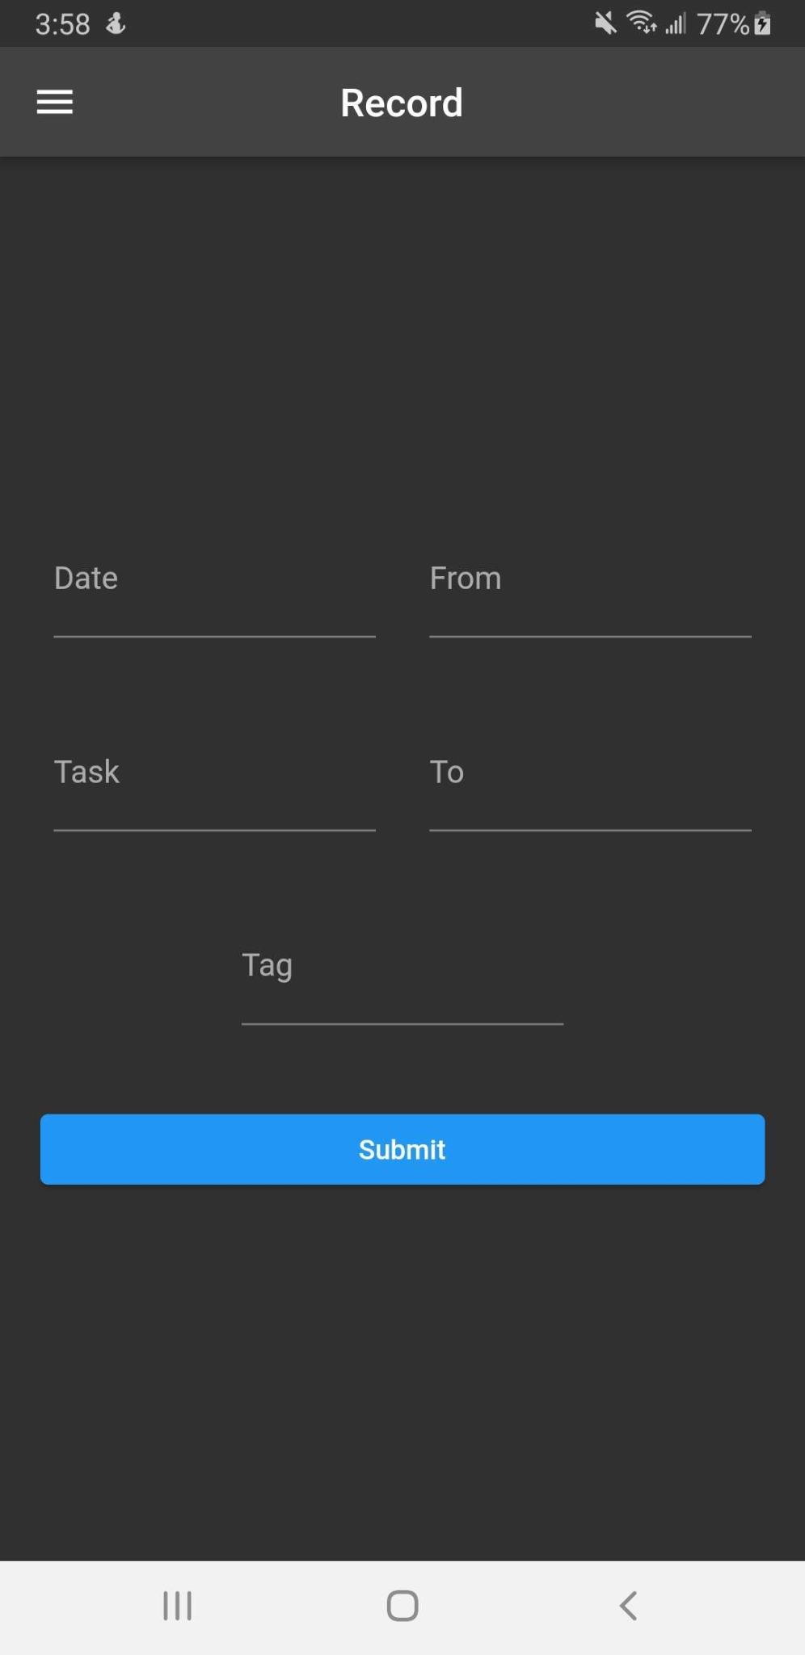
Record Command
Used to record time usage on a specific date and time range
3

Slide 4
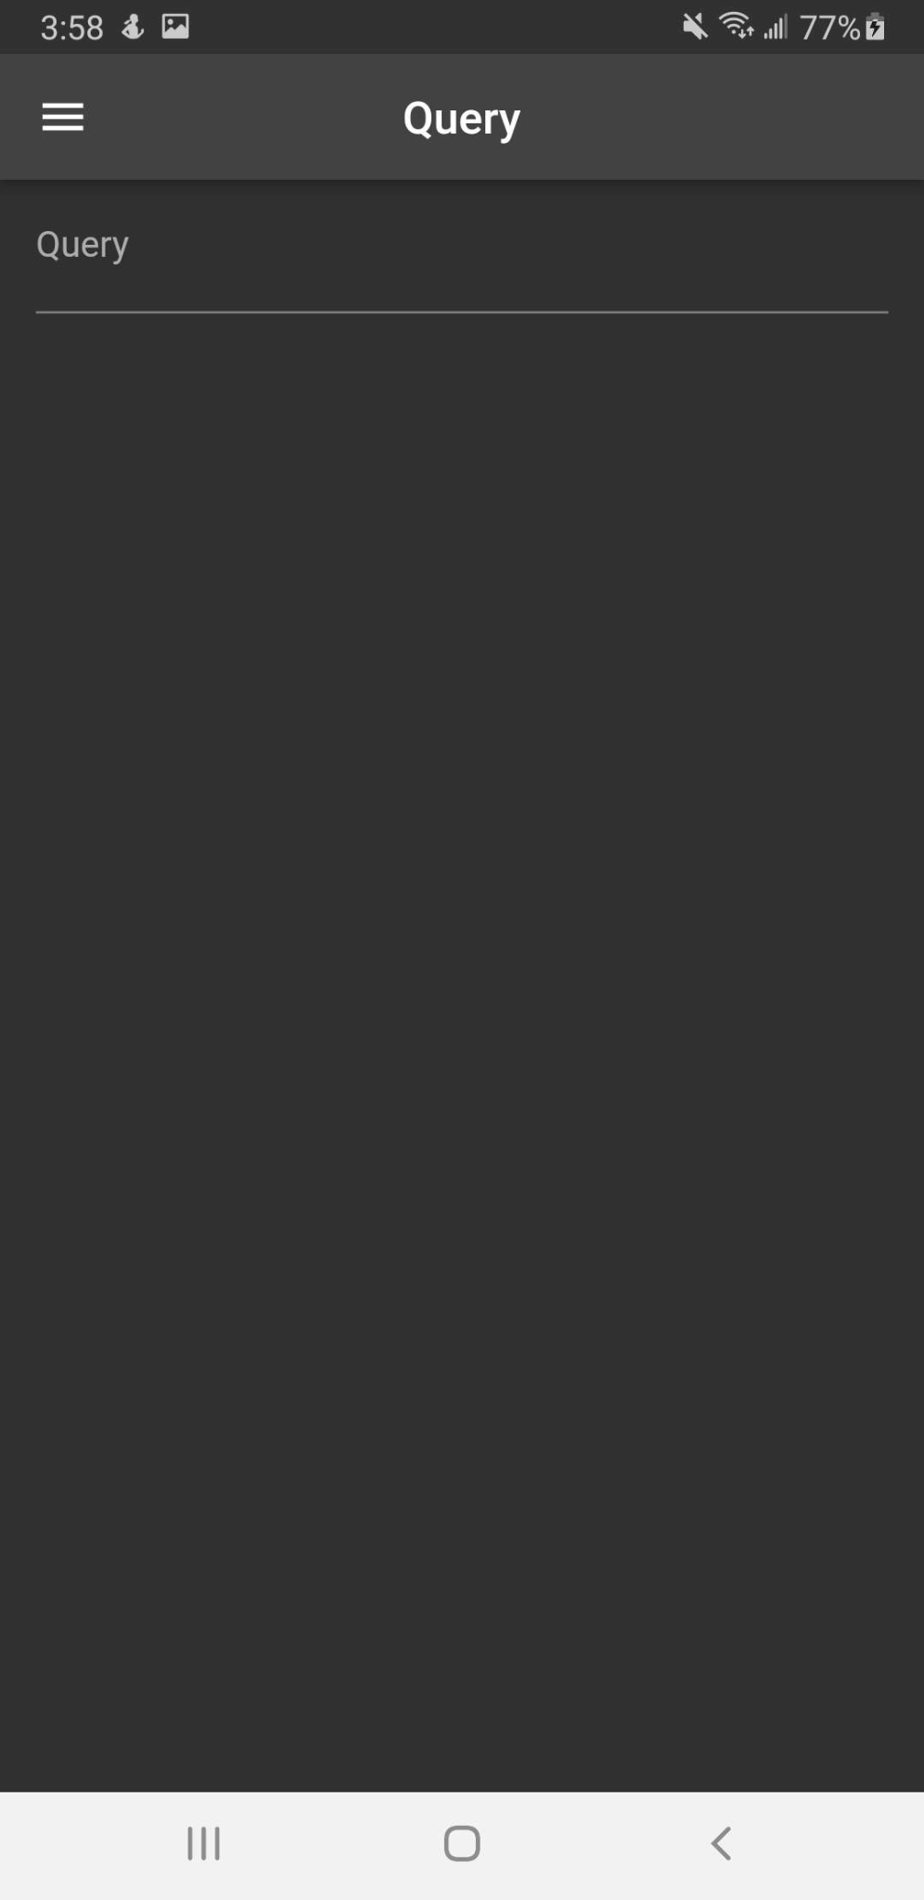
Query Command
Used to find a specific entry using a query
4

Slide 5
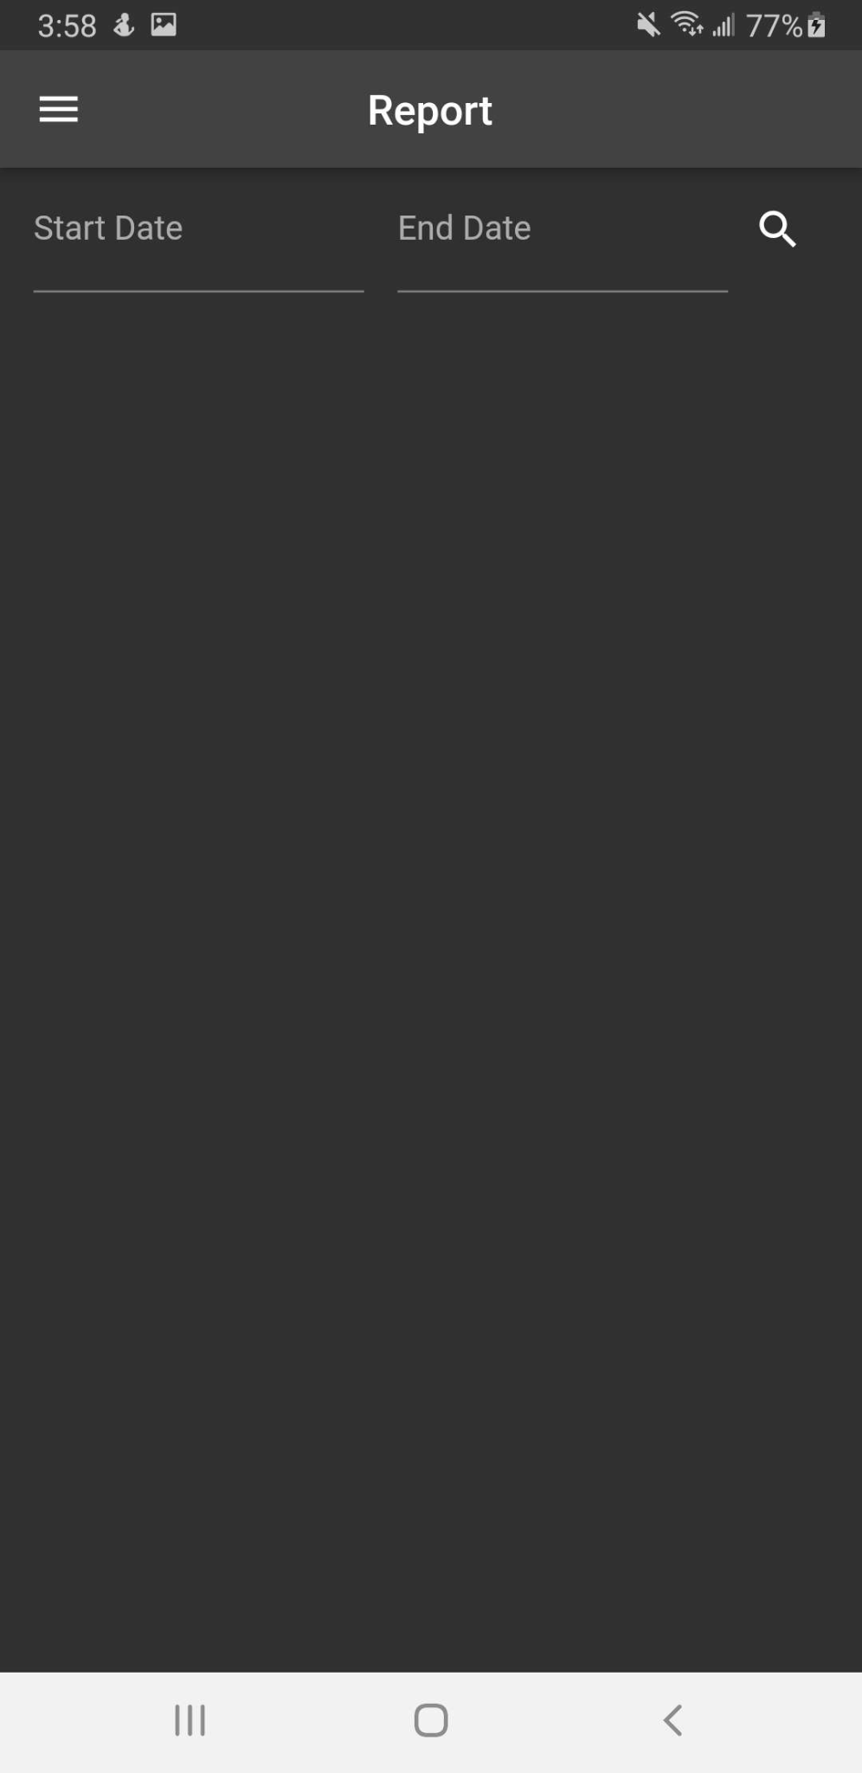
Report Command
Creates a report of all tasks between 2 dates
5

Slide 6
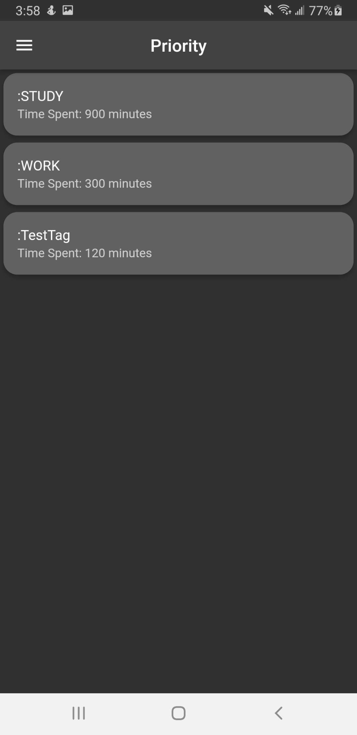
Priority Command
Creates a list of the tag with the time spent on the most
6

Slide 7
747
Lines of Code
7

